Slide 1
!
ATTITUDE
IS
EVERY THING

Slide 2
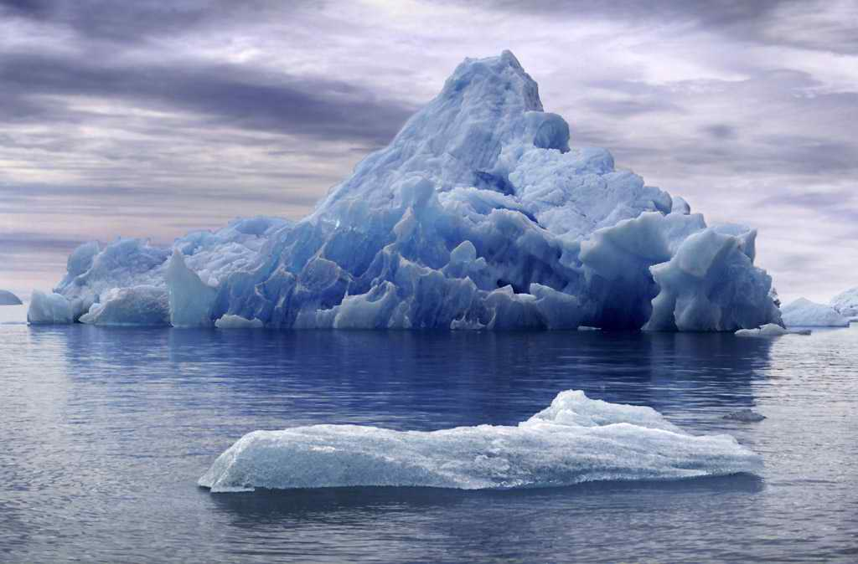

THE ICEBERG
HOW MUCH DO YOU SEE OF AN ICEBERG?

Slide 3
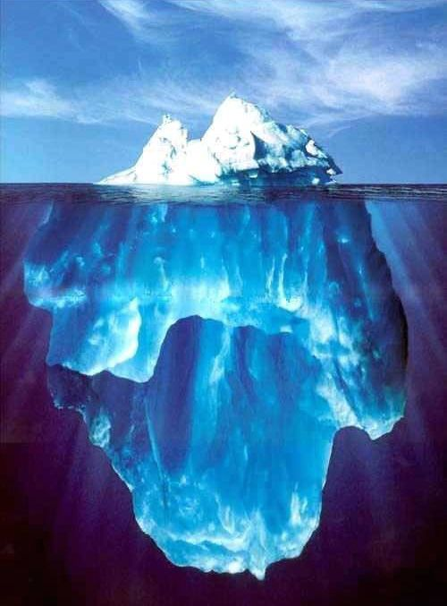
THE ICEBERG
ONLY 10 OF ANY ICEBERG IS VISIBLE. THE REMAINING 90% IS BELOW SEA LEVEL.

Slide 4
THE ICEBERG
10 %
VISIBLE
ABOVE SEA LEVEL
SEA LEVEL
INVISIBLE
BELOW SEA LEVEL
90 %

Slide 5
THE ICEBERG
The Iceberg phenomena is also applicable on human beings …

Slide 6
THE ICEBERG
KNOWLEDGE
&
SKILLS
KNOWN
TO OTHERS
SEA LEVEL
UNKNOWN
TO OTHERS
ATTITUDE

Slide 7
THE ICEBERG
In other words,

Slide 8
THE ICEBERG
BEHAVIOR
KNOWN
TO OTHERS
SEA LEVEL
UNKNOWN
TO OTHERS
IMPACT
VALUES – STANDARDS – JUDGMENTS
ATTITUDE
MOTIVES – ETHICS - BELIEFS

Slide 9
WHAT MAKES YOUR LIFE 100% ?
Let each letter of the alphabetic has a value equals to it sequence of the alphabetical order:
A | B | C | D | E | F | G | H | I | J | K | L | M | N | O | P | Q | R | S | T | U | V | W | X | Y | Z
1 | 2 | 3 | 4 | 5 | 6 | 7 | 8 | 9 | 10 | 11 | 12 | 13 | 14 | 15 | 16 | 17 | 18 | 19 | 20 | 21 | 22 | 23 | 24 | 25 | 26
S | K | I | L | L | S
19 | 11 | 9 | 12 | 12 | 19
=
82
K | N | O | W | L | E | D | G | E
11 | 14 | 15 | 23 | 12 | 5 | 4 | 7 | 5
=
96
H | A | R | D |  | W | O | R | K
8 | 1 | 12 | 4 |  | 23 | 15 | 18 | 11
=
98
A | T | T | I | T | U | D | E
1 | 20 | 20 | 9 | 20 | 21 | 4 | 5
=
100

Slide 10
THE CAN DO ATTITUDE
You CAN DO everything, but not all at once.
You CAN DO everything, if it’s important enough for you to do.
You CAN DO everything, but you may not be the best at everything.
You CAN DO everything, but there will be limitations.
You CAN DO everything, but you’ll need help.

Slide 11
BEST QUOTES ON POSITIVE ATTITUDE
A positive thought is the seed of a positive result.
If you don’t like something, change it. If you can’t change it, change your attitude. Don’t complain.
The most significant change in a person’s life is a change of attitude. Right attitudes produce right actions.
If you really want to be happy, nobody can stop you except God.

Slide 12
BEST QUOTES ON POSITIVE ATTITUDE
Whether a glass if half-full or half-empty, depends on the attitude of the person looking at it.
There is a better way for everything. Find it.
A positive attitude is not a destination. It is a way of life.
The difference between a successful person and others is not a lack of knowledge, but rather a lack of will.

Slide 13
BEST QUOTES ON POSITIVE ATTITUDE
The positive thinker sees the invisible, feels the intangible, and achieves the impossible.
The man with confidence in himself gains the confidence of others.
You will only go as far as you think you can go.
The biggest mistake of all is to avoid situations in which you might make a mistake.

Slide 14
BEST QUOTES ON POSITIVE ATTITUDE
A positive attitude is like a magnet for positive results.
Our life is a reflection of our attitudes.
Positive attitudes create a chain reaction of positive thoughts.
Attitude, not aptitude, determines your altitude.
No man fails if he does his best.

Slide 15
BEST QUOTES ON POSITIVE ATTITUDE
Sooner or later, those who win are those who think they can.
A creative attitude is the fuel of progress and growth.
Either I will find a way, or I will make one.
Be the change you want to see in this world.
Forgive others and you will be forgiven.

